Slide 1
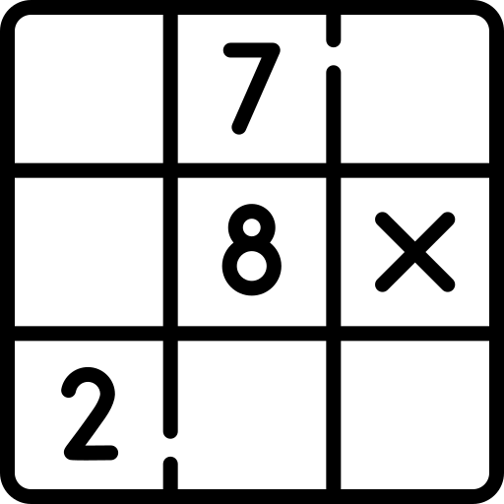
Sudoku solver
project
by Daniil Khlyvniuk

Slide 2
About me
Daniil Khlyvniuk
22 years old
3+ years of commercial experience in Fullstack Web development
My stack:
JS / Node.js
React / Angular
Nest.js / express
Third year as a software engineering student

Slide 3

Project description
This is the web service for solving sudoku
Upload your image, pass a link or select default image for test
Get a result image with filled sudoku
Saving user input history
Gets some stats, charts, info about my dijit classifier model
Why sudoku?
Opportunity to implement “CV” part
Opportunity to implement my custom dijit classifier model
A lot of go-to information, guides, tutorials about dijit classifier model
Simple usage as a web service

Slide 4

Demo

Slide 5

Frontend
UI
User’s input
Display:
Result sudoku image
Users history

Slide 6

Database api
Save user to db
Save user’s sudokus to db
Save user’s images to S3 bucket

Slide 7

AI api
Trains model for detection digits
Saves and contains model for detection digits
Processing sudoku images
Resolving sudokus
Creating resolved sudoku image

Slide 8

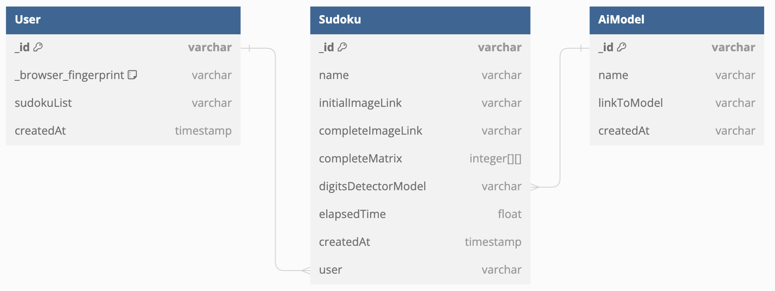
Database

Slide 9


















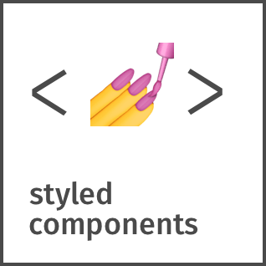











Application architecture and technology stack
Frontend | database-backend | ai-backend | services / tools

Slide 10
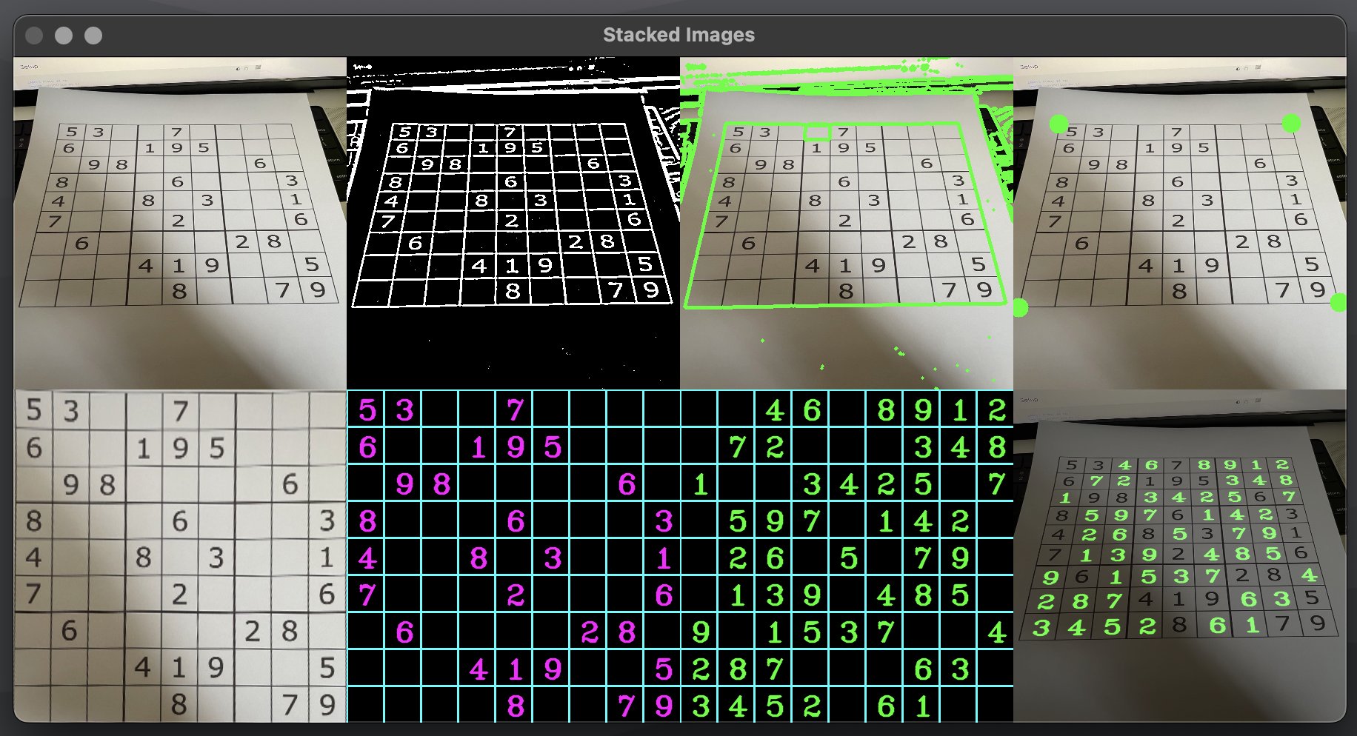
Detect numbers flow
Detect the sudoku game (the biggest squared contour)
Get corner point
Aligned perspective
Split every single field
Process every single field
Detect a number on the field

Slide 11
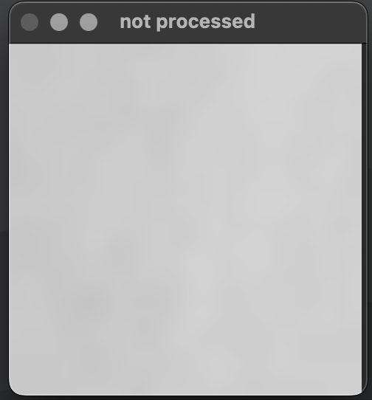
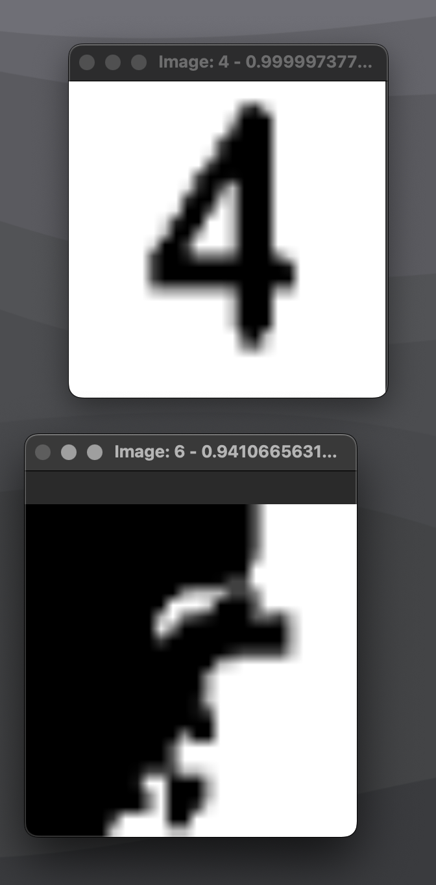
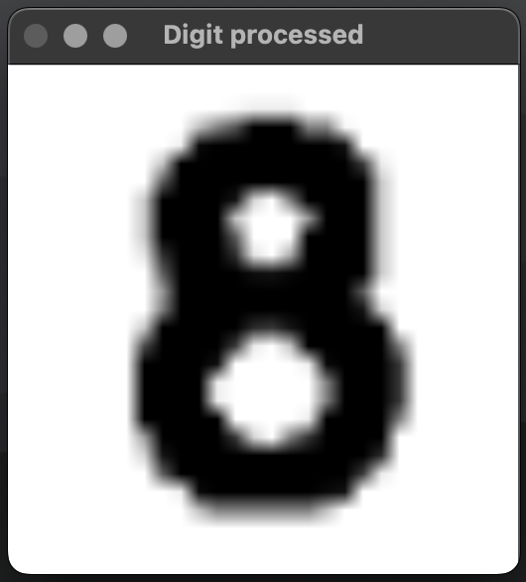
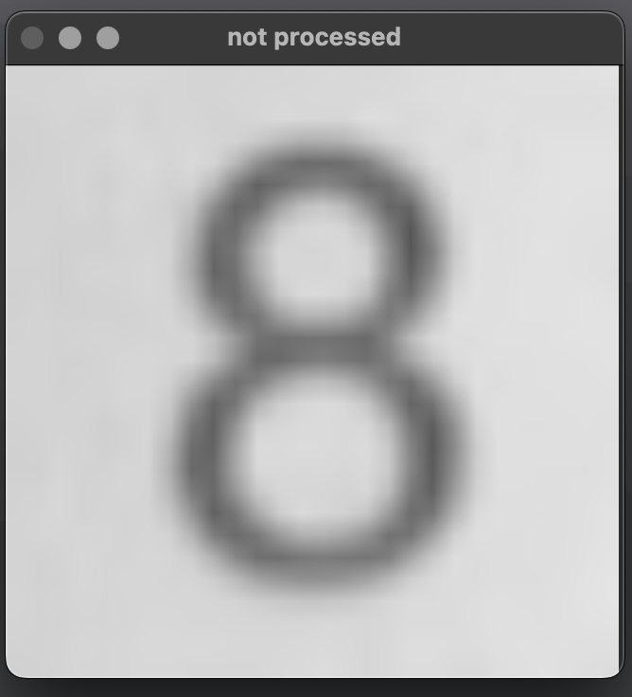
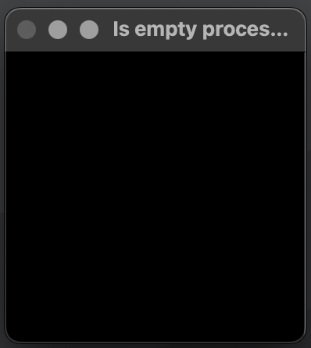
Number image processing
Grayscale initial images:
Processed
8
empty (“0”)
8
4
empty (“0”)
cv2.morphologyEx()
Processing for “is_empty” check
cv2.threshold()
cv2.Canny()
empty (“0”)

Slide 12
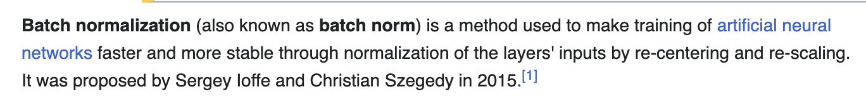
def create_model():
created_model = Sequential()
created_model.add(Conv2D(32, kernel_size=3, activation='relu', input_shape=(28, 28, 1)))
created_model.add(BatchNormalization())
created_model.add(Conv2D(32, kernel_size=3, activation='relu'))
created_model.add(BatchNormalization())
created_model.add(Conv2D(32, kernel_size=5, strides=2, padding='same', activation='relu'))
created_model.add(BatchNormalization())
created_model.add(Dropout(0.4))
created_model.add(Conv2D(64, kernel_size=3, activation='relu'))
created_model.add(BatchNormalization())
created_model.add(Conv2D(64, kernel_size=3, activation='relu'))
created_model.add(BatchNormalization())
created_model.add(Conv2D(64, kernel_size=5, strides=2, padding='same', activation='relu'))
created_model.add(BatchNormalization())
created_model.add(Dropout(0.4))
created_model.add(Conv2D(128, kernel_size=4, activation='relu'))
created_model.add(BatchNormalization())
created_model.add(Flatten())
created_model.add(Dropout(0.4))
created_model.add(Dense(10, activation='softmax'))
created_model.compile(optimizer=Adam(learning_rate=0.001), loss='categorical_crossentropy', metrics=['accuracy'])
return created_model
Digit classifier model (first try)

Slide 13
def create_model():
model = Sequential()
model.add(Conv2D(32, kernel_size=(3, 3), activation='relu', input_shape=(28, 28, 1)))
model.add(BatchNormalization())
model.add(Conv2D(64, (3, 3), activation='relu'))
model.add(BatchNormalization())
model.add(MaxPool2D(pool_size=(2, 2)))
model.add(Dropout(0.25))
model.add(Flatten())
model.add(Dense(128, activation='relu'))
model.add(BatchNormalization())
model.add(Dropout(0.5))
model.add(Dense(10, activation='softmax'))
model.compile(
loss=categorical_crossentropy,
optimizer=Adam(learning_rate=0.001),
metrics=['accuracy']
)
return model
Improved second try

Slide 14
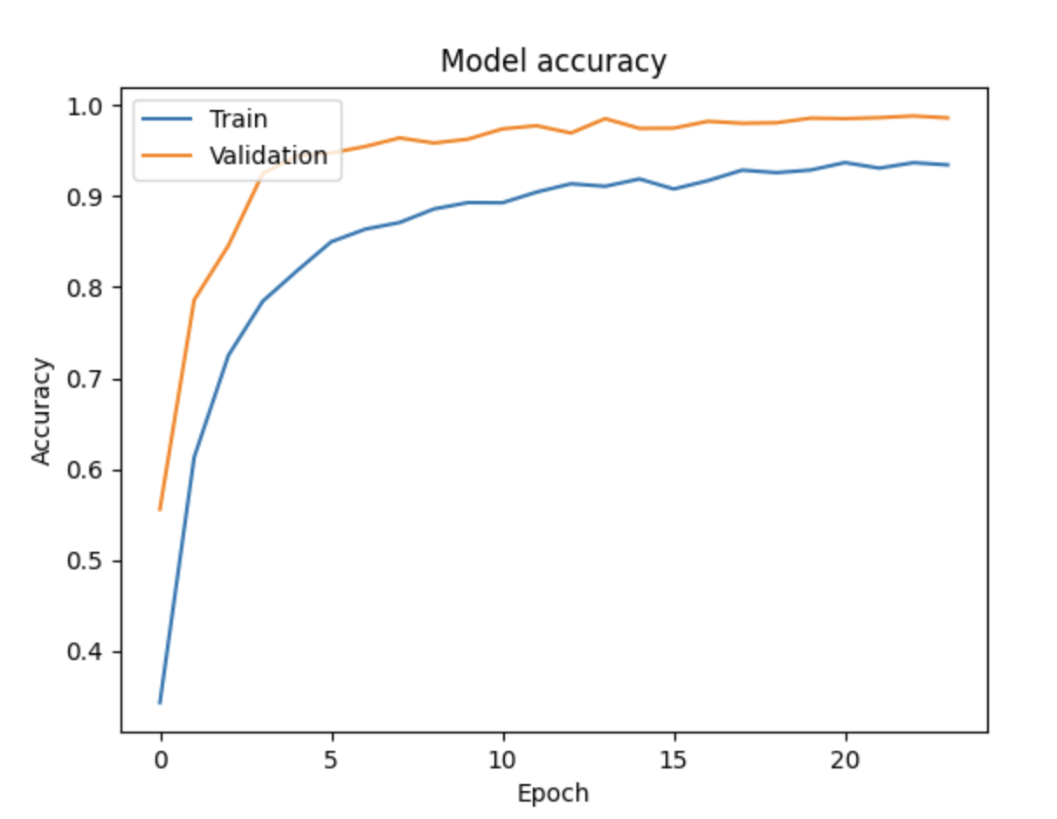
def improved_model():
model = Sequential()
model.add(Conv2D(32, kernel_size=(3, 3), activation='relu', input_shape=(28, 28, 1)))
model.add(Conv2D(64, (3, 3), activation='relu'))
model.add(MaxPooling2D(pool_size=(2, 2)))
model.add(Dropout(0.25))
model.add(Conv2D(128, (3, 3), activation='relu'))
model.add(BatchNormalization())
model.add(MaxPooling2D(pool_size=(2, 2)))
model.add(Dropout(0.25))
model.add(Flatten())
model.add(Dense(512, activation='relu'))
model.add(BatchNormalization())
model.add(Dropout(0.5))
model.add(Dense(10, activation='softmax'))
model.compile(optimizer=Adam(learning_rate=0.001), loss='categorical_crossentropy', metrics=['accuracy'])
return model
Final digit classifier model
COUNT_CLASSES = len(DATASET_CLASSES) # 10
TEST_RATIO = 0.2
VALIDATION_RATIO = 0.3
RANDOM_STATE = 42
BATCH_SIZE = 30
EPOCHS = 24
# steps_per_epoch = len(x_train) // BATCH_SIZE

Slide 15


Oh, shoot . . .

Slide 16
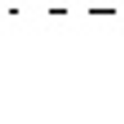

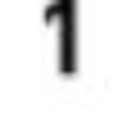

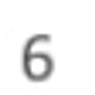

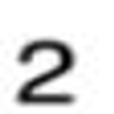
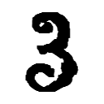
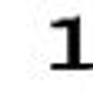
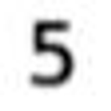
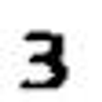




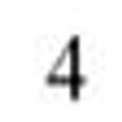


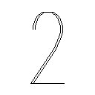
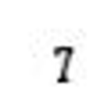
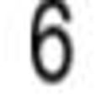
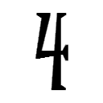
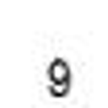
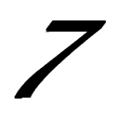
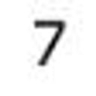

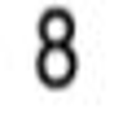
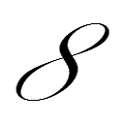
Dataset example
10 classes ~1600 per class
“0” ~ 642 items
“1” ~ 1 864 items
“2” ~ 1 767 items
“3” ~ 1 622 items
“4” ~ 1 647 items
“5” ~ 1 609 items
“6” ~ 1 543 items
“7” ~ 1 705 items
“8” ~ 1 577 items
“9” ~ 1 582 items
from keras.preprocessing.image import ImageDataGenerator
data_gen = ImageDataGenerator(
width_shift_range=0.2,
height_shift_range=0.2,
zoom_range=0.2,
rotation_range=20,
)
COUNT_CLASSES = len(DATASET_CLASSES) # 10
TEST_RATIO = 0.2
VALIDATION_RATIO = 0.3
RANDOM_STATE = 42
BATCH_SIZE = 30
EPOCHS = 24
# steps_per_epoch = len(x_train) // BATCH_SIZE

Slide 17
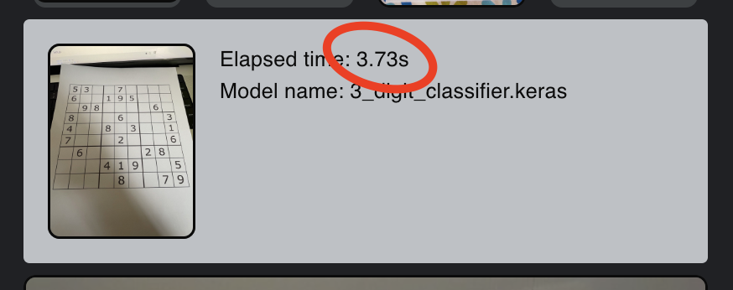

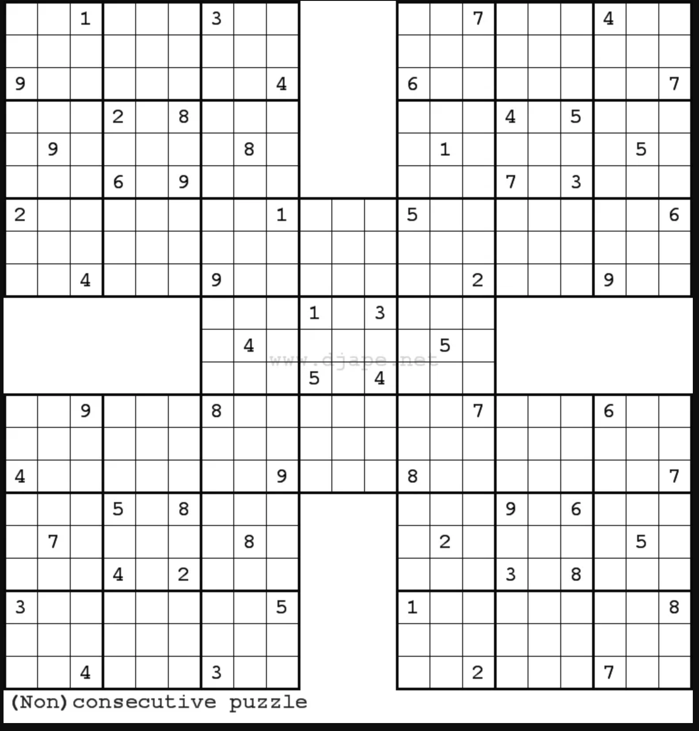
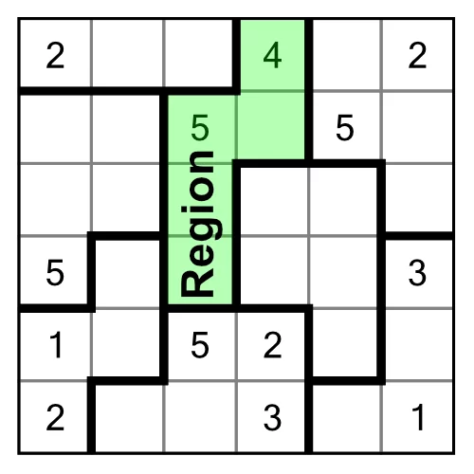
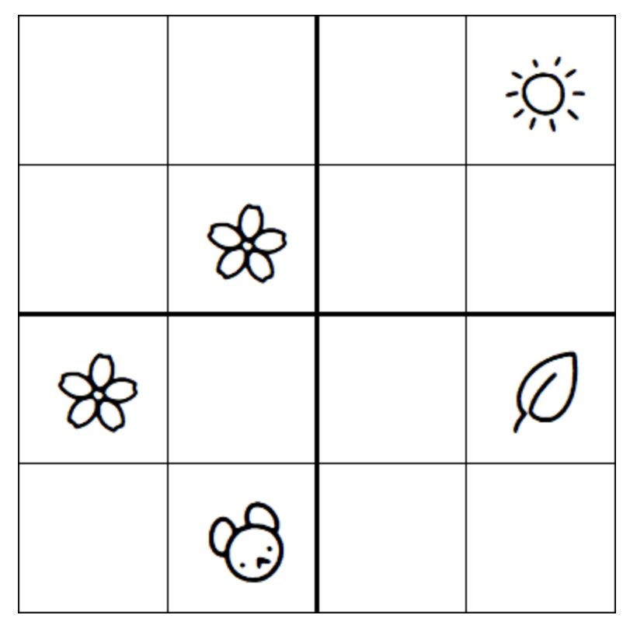
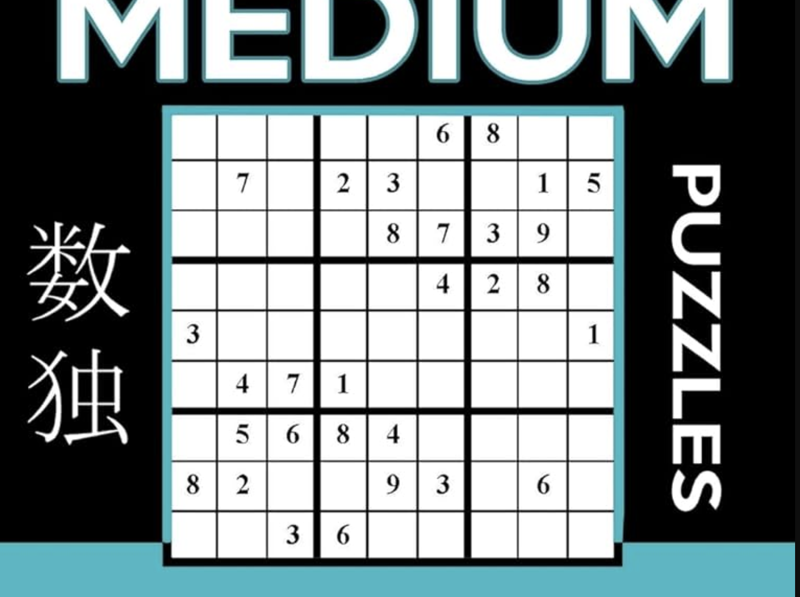
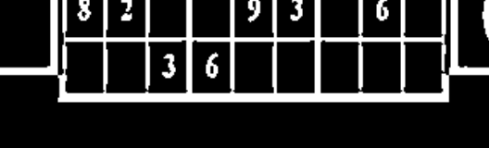
Issues
9x9 sudoku only;
Solid mono-color borders only. Dashed, two colored, double lined, blurred, crooked etc. borders are not supported
Sudoku overlaps another picture;
Some fonts are not supported;
Small or low quality images are not supported;
A few sudoku fields at the photo are not supported;
Performance not so incredible. Processing time is about 4s;

Slide 18

Questions 🤔
¿¿¿ Any questions ???

Slide 19
Links, articles, docs, etc.
Theailearner
Kaggle
OpenCV docs
Tenserwlow python docs
One of datasets
React docs
NestJS docs
Mongodb docs
Mongoose ODM docs
FastAPI docs
Amazon S3 bucket docs
Python3 docs
Contour features open-cv docs

Slide 20
Source code
source code

Slide 21

Good bye 👋!
Thanks for your attention!

